Slide 1
Pipelined Reliable data transfer protocols

Slide 2
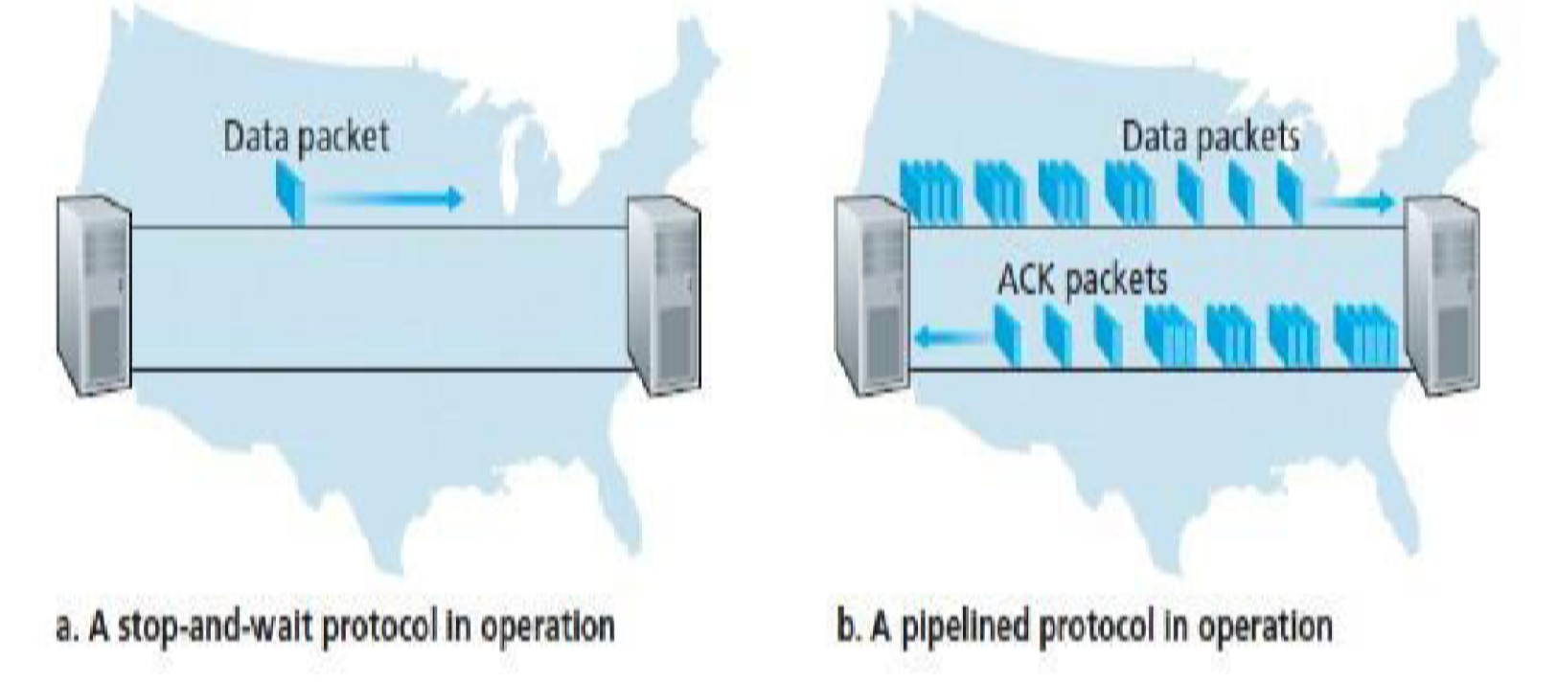

Slide 3

CONSIDER,
Round-trip Time(RTT) = 30 milliseconds
Transmission Rate , R = 1 Gbps
Packet Size , L =1000 bytes (8000 bits per packet)

Slide 4

Above Figure (a) shows that with our stop-and-wait protocol, if the sender begins sending the packet at t = 0, then at t = L/R = 8 microseconds,
the last bit enters the channel at the sender side. The packet then makes its 15-msec cross-country journey, with the last bit of the packet emerging at the receiver at t = RTT/2 + L/R = 15.008 msec.
The ACK emerges back at the sender at t = RTT + L/R = 30.008 msec.
Thus, in 30.008 msec, the sender was sending for only 0.008 msec.
The analysis shows that the stop-and-wait protocol has a rather dismal sender utilization, Usender, of

Slide 5
The solution to this particular performance problem is simple: Rather than operate in a stop-and- wait manner, the sender is allowed to send multiple packets without waiting for acknowledgments.
Pipelining has the following consequences for reliable data
transfer protocols:
The range of sequence numbers must be increased, since each in-transit packet (not counting retransmissions) must have a unique sequence number and there may be multiple, in-transit, unacknowledged packets.
The sender and receiver sides of the protocols may have to buffer more than one packet.
Two basic approaches toward pipelined error recovery can be identified: Go-Back-N and selective repeat.

Slide 6
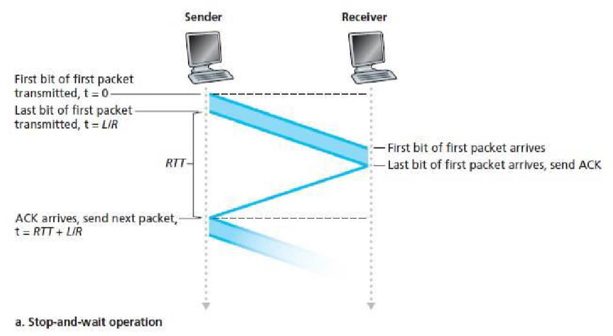

Slide 7
